Slide 1

Digital Signature In Blockchain using ECDSA
Sereen Abdullah 20190212

Slide 2
introduction
Blockchain technology, it is a technology that mixes distributed data capabilities with the protection that unauthorized individuals will not be able to find the data delivered in a single transaction, and because of that it's among the most creative solutions for supporting organizations in protecting the security of the data.
The following discussion will focus on the significance of digital signatures in the context of blockchain.

Slide 3

ECDSA stands for the Elliptic Curve Digital Signature Algorithm which is currently in use for the as a signature algorithm in use in Bitcoin. Consider an elliptic curve group as a constrained set of points on a curve where one operation is easy in one direction but difficult in the other.
In comparison to RSA, ECDSA uses shorter keys and requires fewer processing resources while maintaining good security.

Slide 4
This algorithm consists of four main requirements:
The first element is that the universal domain variables.
The second one is that a sender should first create a pair of keys (public/private) key.
The third one is that for message to be signed a hash value must be generated.
The fourth one is for the message to be verified by the receiver they will use the public key, the domain settings, and the integer x as inputs.

Slide 5
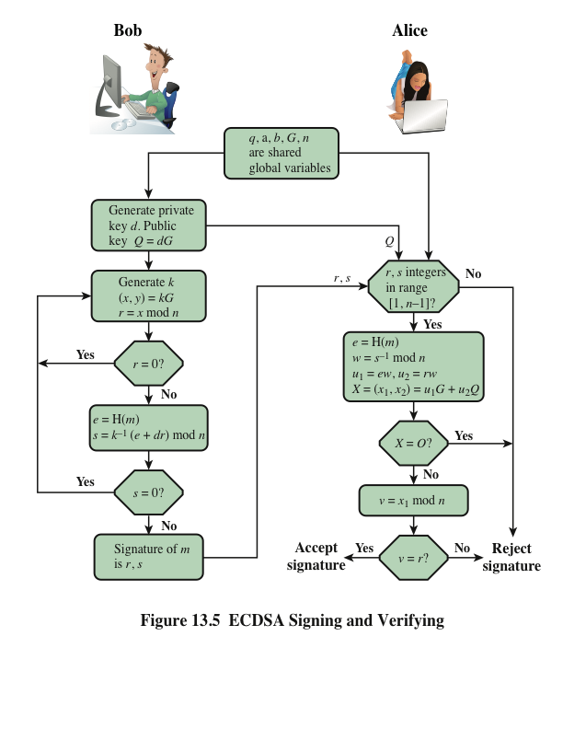
Shared global variables:
1)‘a‘ and ‘b‘ are the parameters of the curve function (y^2 = x^3 + ax + b)
2) ‘p‘ is the prime number
3) ‘n‘ is the number of points of the curve
4) ‘G‘ represents a ‘reference point’ or a point of origin if you prefer. The reference point could be any point on the curve.

Slide 6

The prosses of the ECDSA:
1- Key Generation:
An ECDSA authenticator requires knowledge of its private key to work. The secret key and domain parameters are used to generate the public key.
A random number generator is generated, and after it is finished, the numeric value that forms the secret keys d is given (a scalar). The public key Q (x, y) is then obtained using point multiplication according to Equation:
Q (x, y) = d × G (x, y).

Slide 7
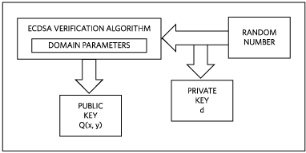

Slide 8
2- Signature Computation:
The signature is represented into two values (s) & (r), so the pair (r, s) together is your ECDSA signature. To calculate the (s) value we need to use a secure hash method, that will represent the input as a message digest H(m).
The following are the characteristics of a secure hash:
Irreversibility.
Collision.
large avalanche effect.

Slide 9
Following the computation of the message digest, a random number generator is used to generate a value k for the elliptic curve computations.
Here we will generate a random number (k), such that (x, y) = k*G, and a random secret number (r), such that r=x mod n.
In this step using a secure hash we the variable-length message is first changed to a fixed-length message digest H(m), e=H(m).
After r is successfully computed, s is computed according to equation using scalar operations. Inputs are the message digest h(m); the private key d; r; and the random number k:
s = (k⁻¹ (h(m) + d * r) mod n

Slide 10
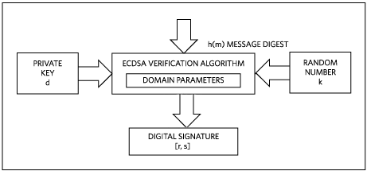

Slide 11
3- Signature Verification:
Its goal is to use the senders’ public key to validate the message's security.
The equation shows the steps of the verification process. Inputs are the message digest h(m), the public key Q (x, y), the signature components r and s, and the base point G (x, y):
e=H(m), hash value (The message digest).
w = s⁻¹ mod n, multiplicative inverse of the signature component (s).
u1 =e*w mod n
u2 =r*w ,
X= (x2, y2) = u1*G + u2* Q

Slide 12
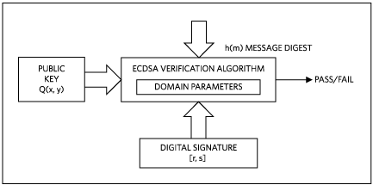

Slide 13

Advantages / Disadvantages
Because ECDSA is new, cybercriminals have had less time to research how to break it. This, along with the complexity of ECDSA, makes it a more enticing option than other public key cryptography functions.
ECDSA has the disadvantage of being difficult to set up, whereas RSA is more straightforward.

